Slide 1

WIND
CHAIRS

Slide 2
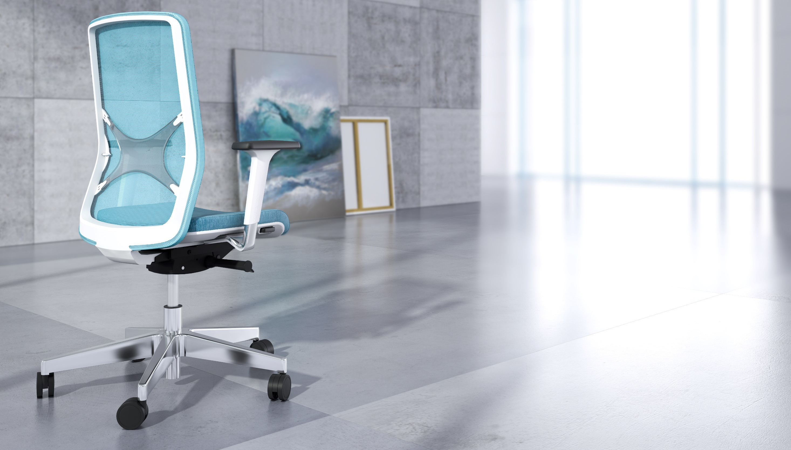


Slide 3
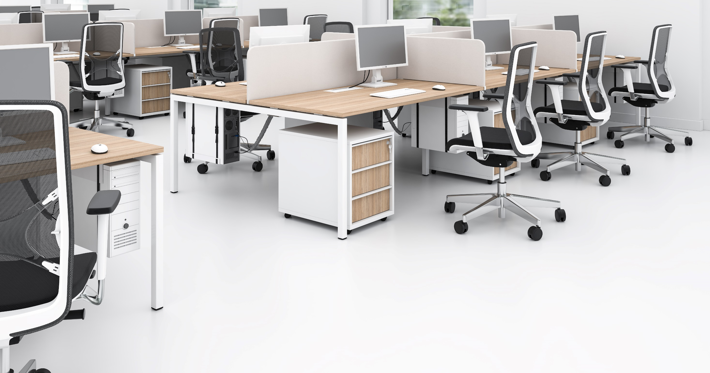
WIND
Ergonomic features, functionality and unique design to create more comfortable and productive workplace.
Design “Baldanzi & Novelli Designers” | Italy

Slide 4


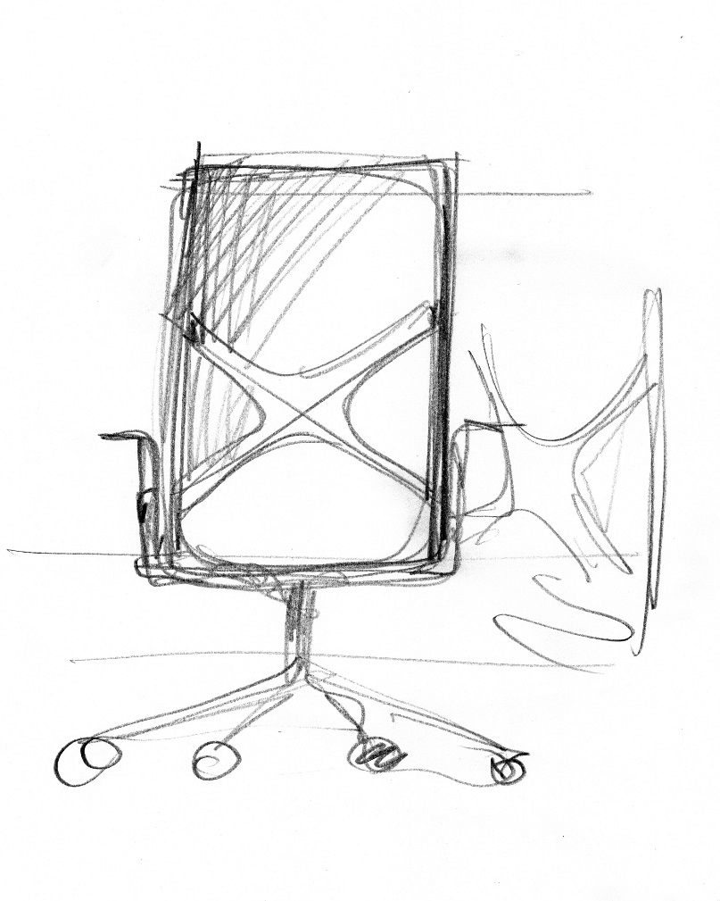
“The inspiration for this product was born from the desire to create a simple but very versatile chair. In addition, we felt the need to give this product a decisive character – an element defining its identity.”
Baldanzi & Novelli Designers

Slide 5
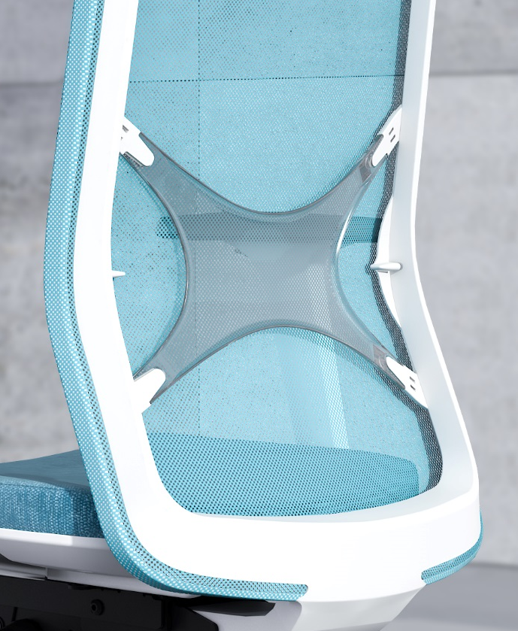
A lumbar support made from
transparent silicon adapts to the shape of the back for your exceptional comfort.
“Clear as the wind setting the sails in the sea or making the tree leaves tremble.”
Baldanzi & Novelli Designers

Slide 6
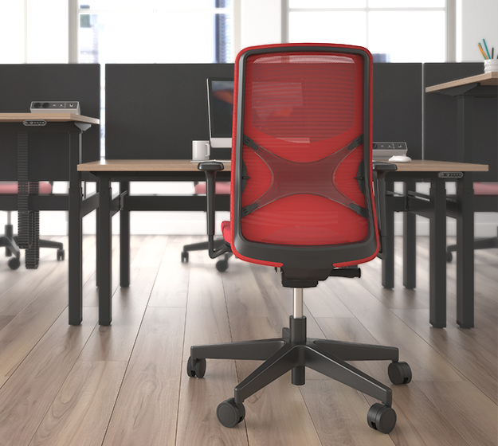
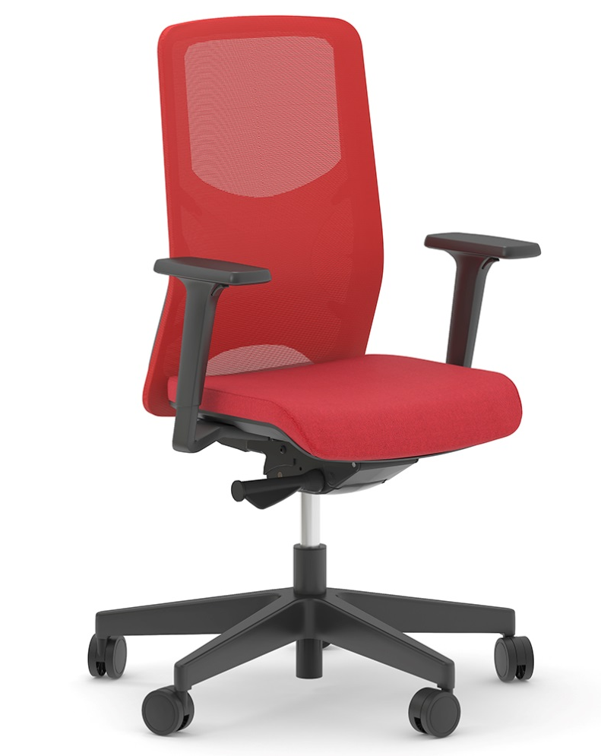
WIND with knitted mesh backrest

Slide 7
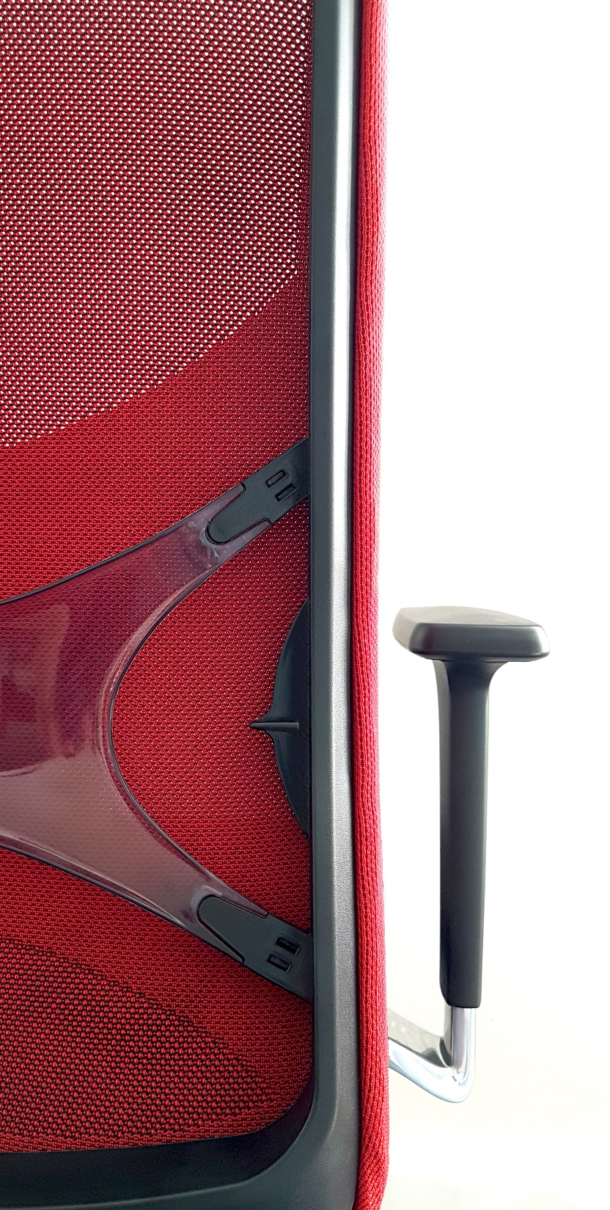
WIND knitted mesh
Unique design
Exclusively designed by Baldanzi & Novelli designers.
No corner stitches
For the sleek look.
Enchanced ergonomics
Additional lumbar support by tightening mesh area for a full comfort of your back.
Zero waste
Knitted mesh is just right size for the backrest frame. No cut-offs during the production.

Slide 8
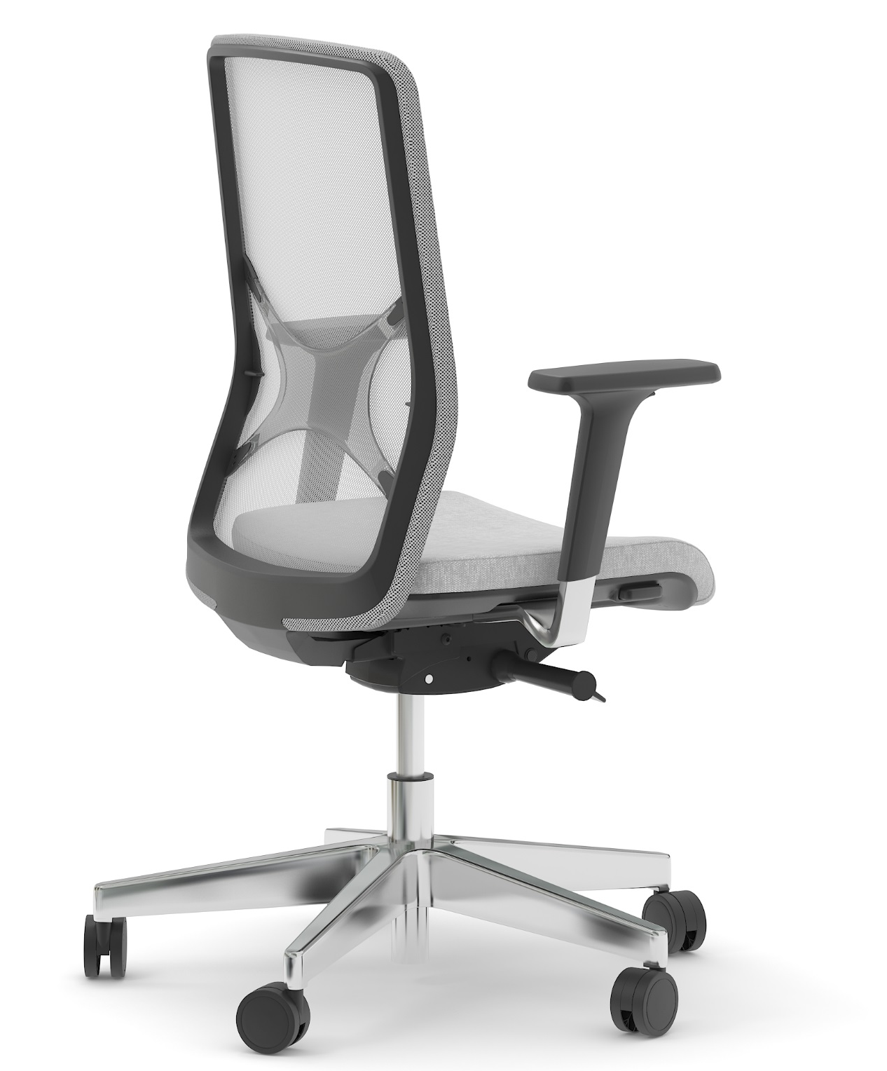
Simple to adjust
ADJUSTABLE LUMBAR SUPPORT
SEAT DEPTH ADJUSTMENT
2D / 3D ADJUSTABLE
ARMRESTS
SYNCHRONOUS MECHANISM
WEIGHT-SENSITIVE
MECHANISM

Slide 9
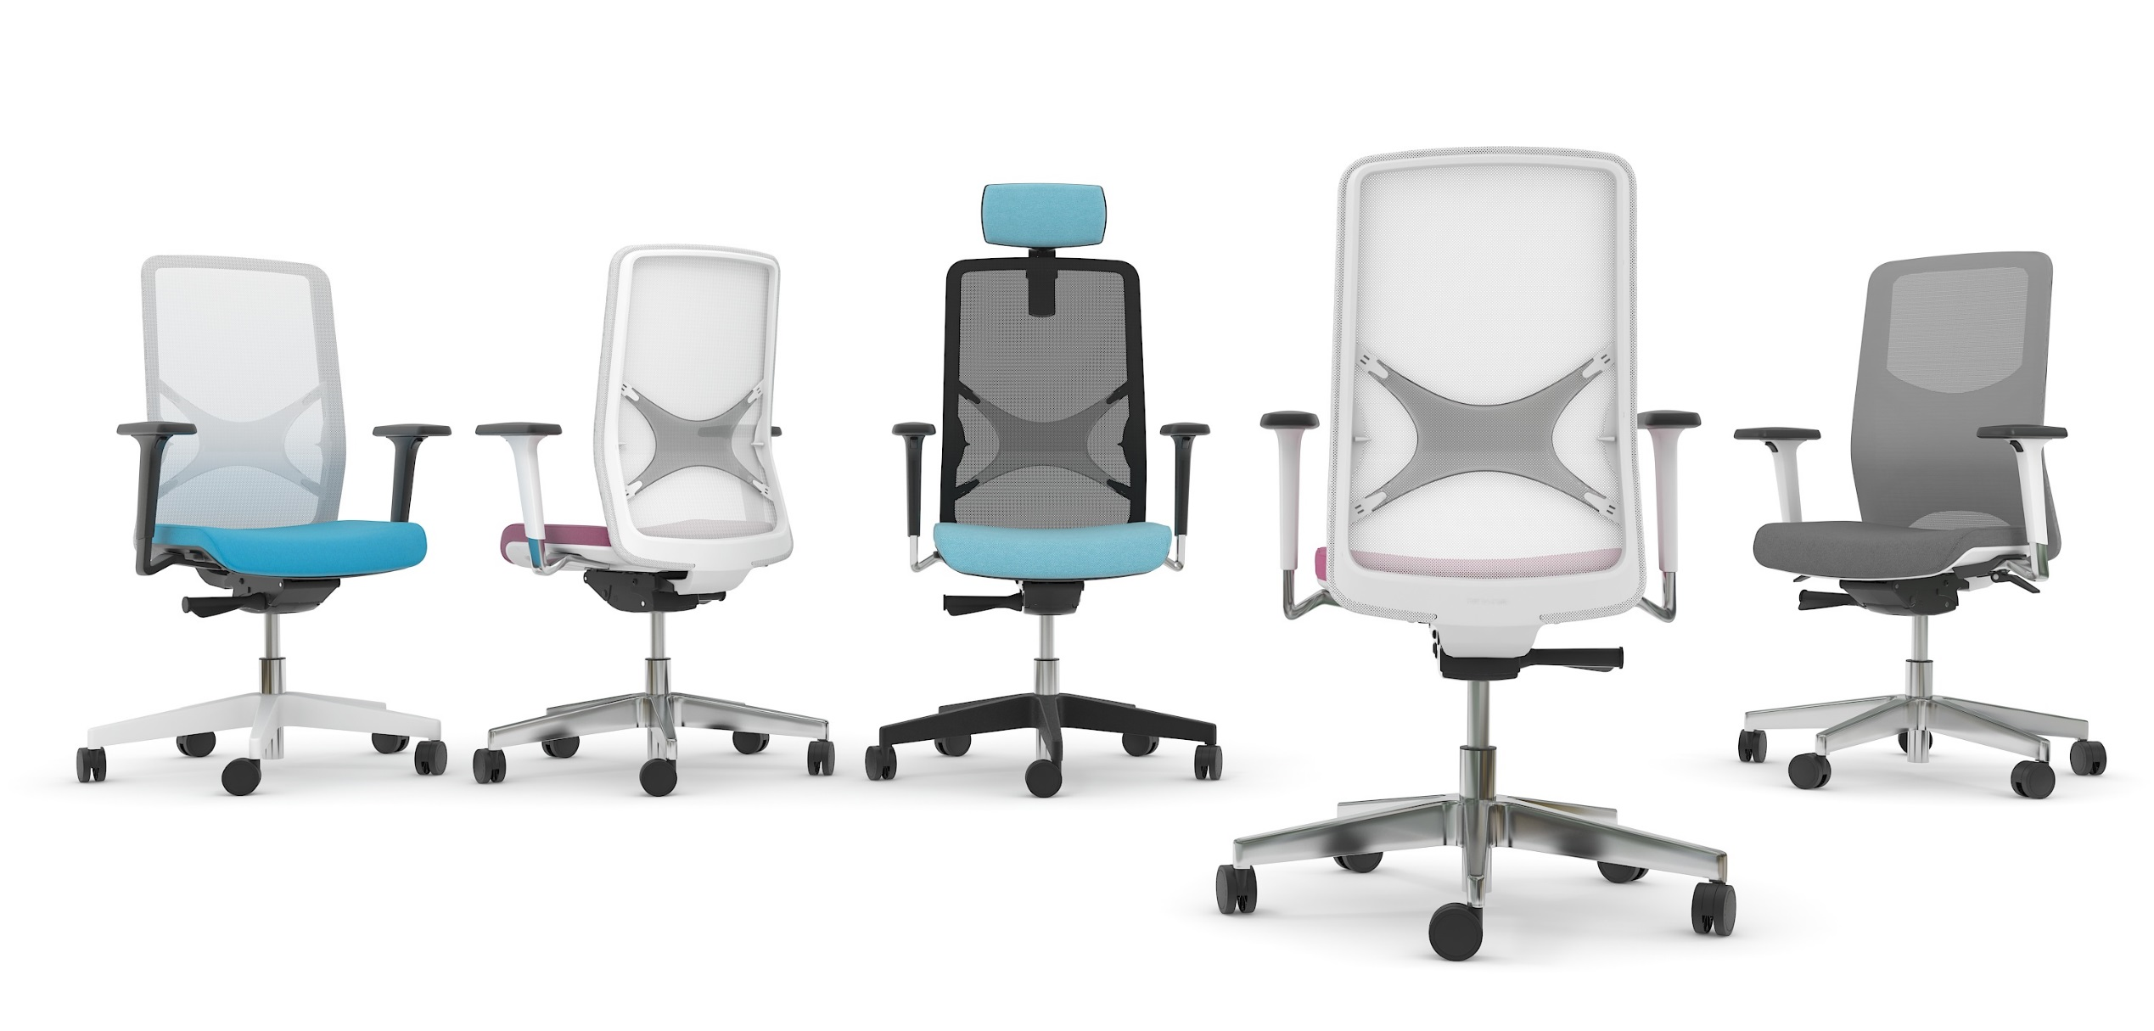
Various combinations available to fulfil your needs.

Slide 10
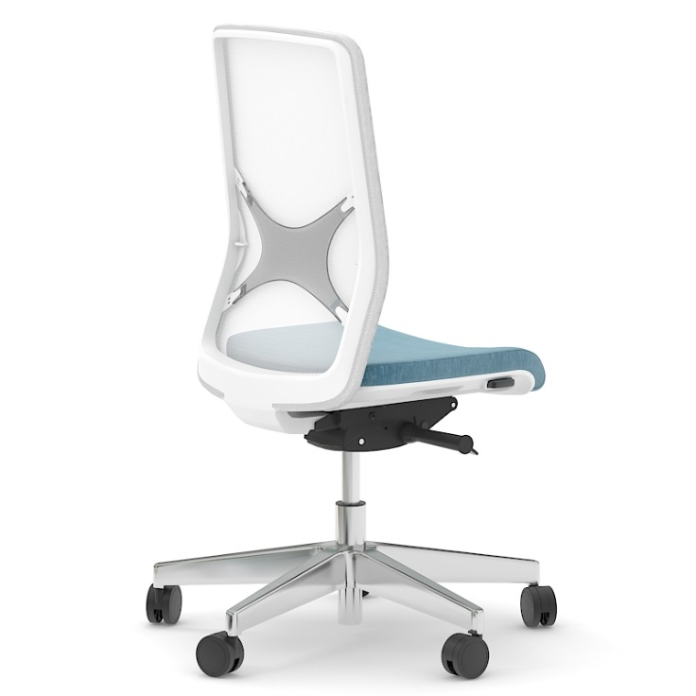
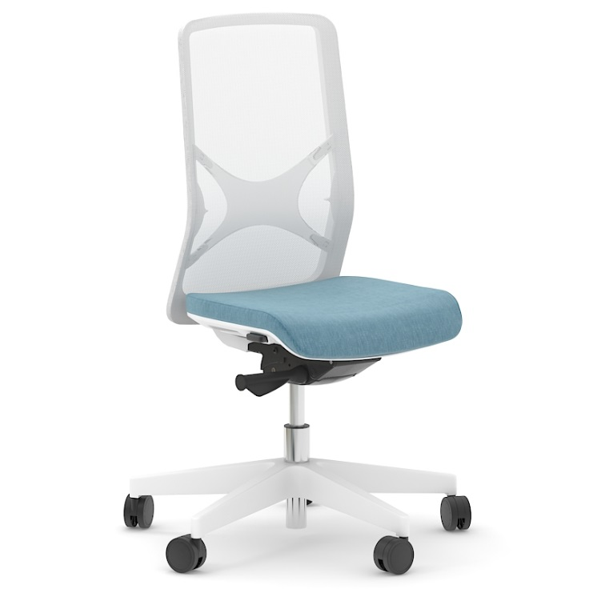
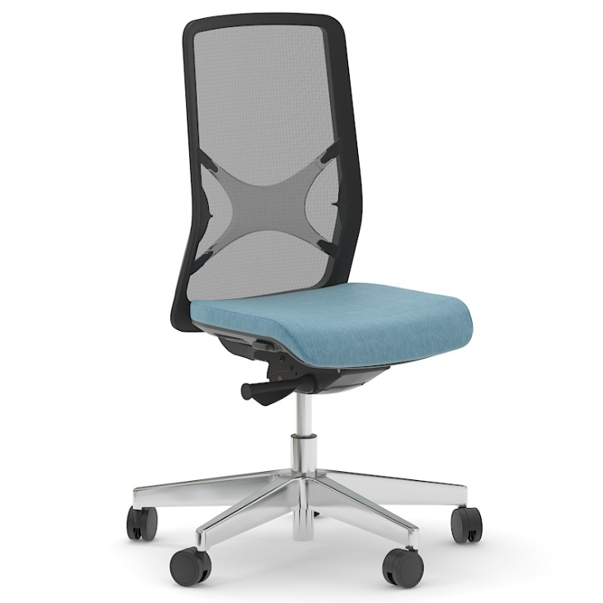
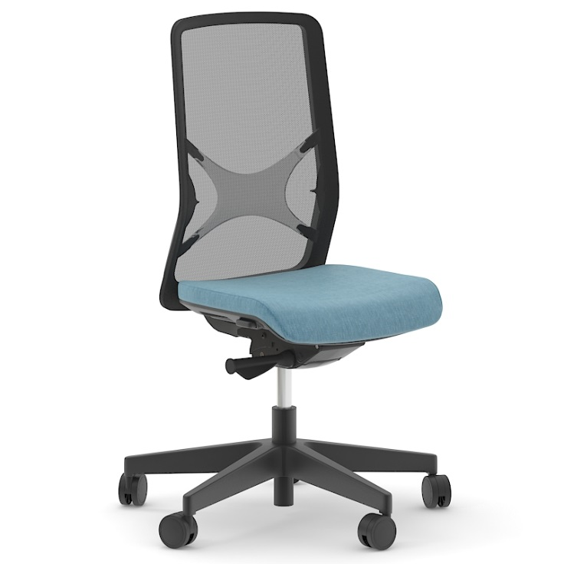
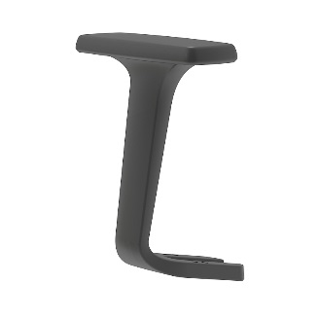
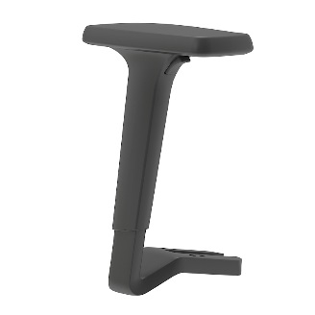
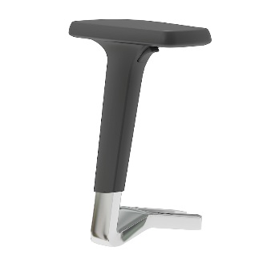
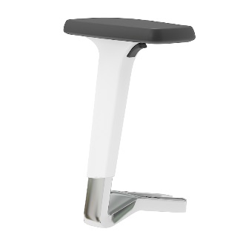
Range
Fixed armrests
2D and 3D adjustable armrests
Headrest

Slide 11
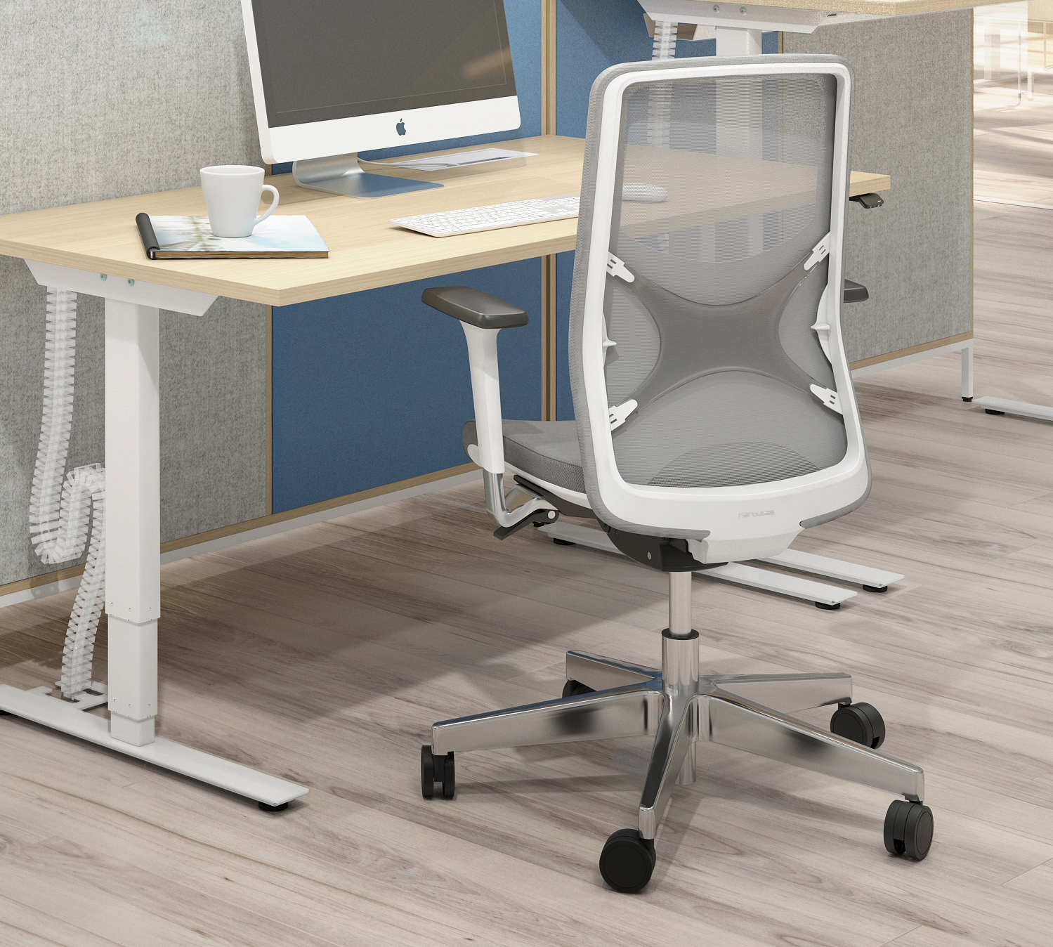
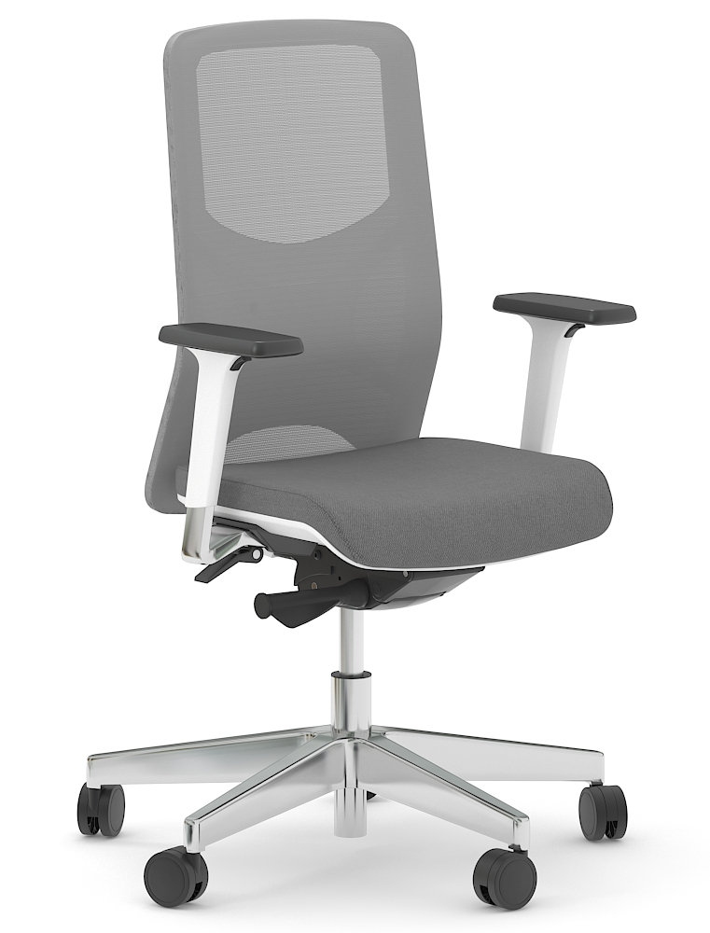

Slide 12
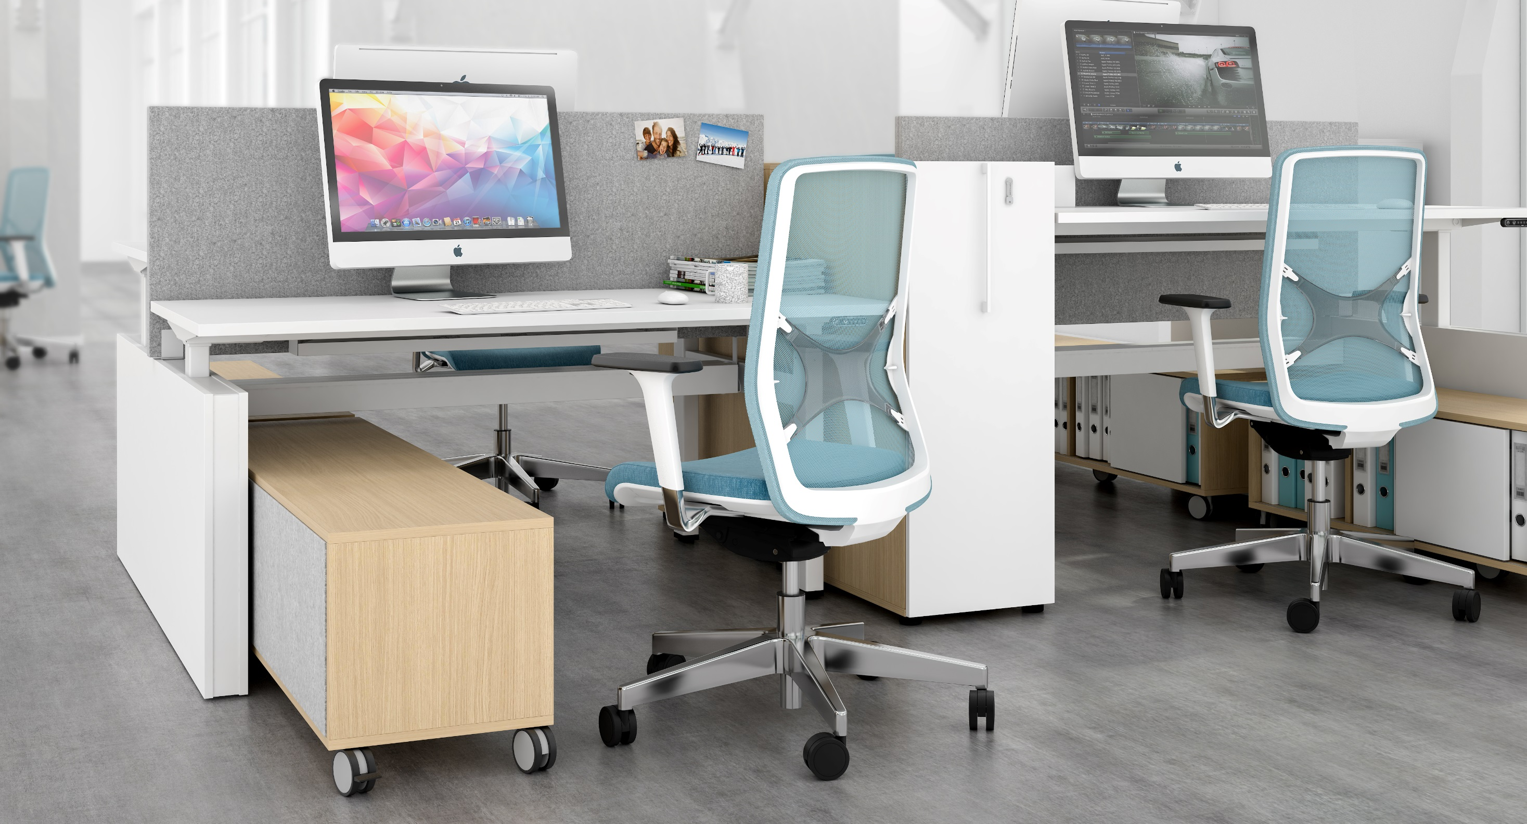

Slide 13



