Slide 1
MOON Chairs System

Slide 2
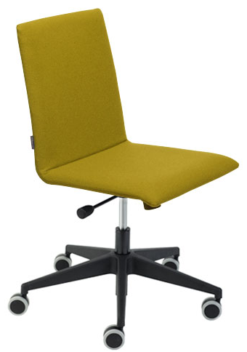
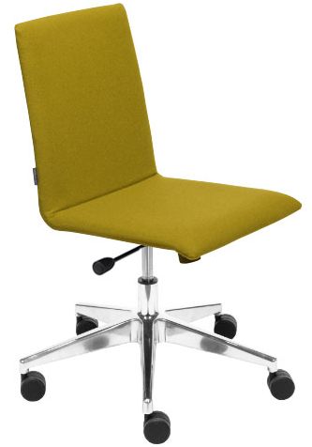
MOON – Operative Chairs
MOON kėdžių sistema
SU
SXC020
SXC120
Task chairs’ characteristics:
Chairs’ backrest and seat is upholstered with fabric, leather look or genuine leather
Fabrics: Bondai, Twist, Xtreme plus, Velito (New!), DNN, RNN
Tilt for active dynamic seated posture with stop in working position
Pneumatic regulation of the height
Base in black plastic or polished aluminium
Casters for soft or hard floors (ø 65 mm)

Slide 3
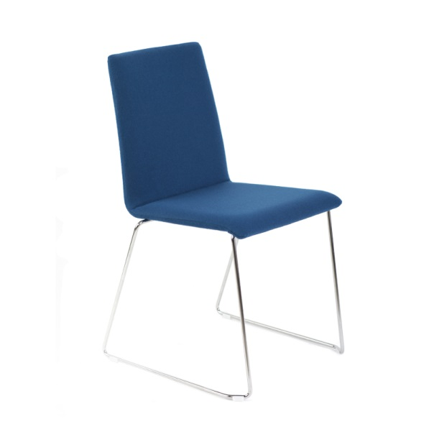
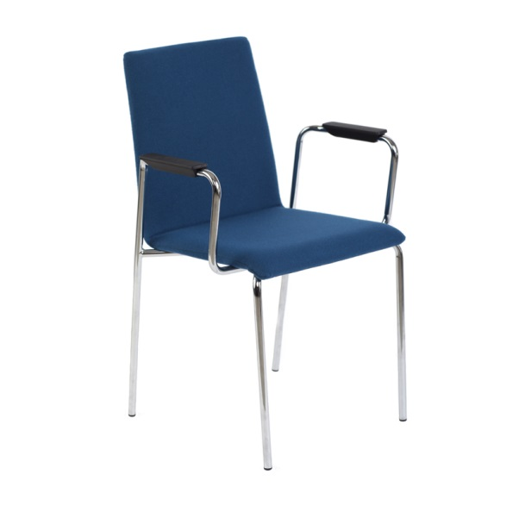
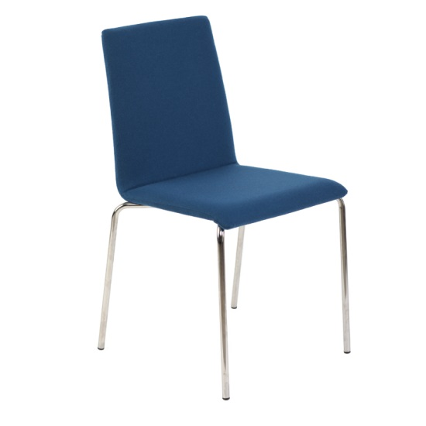
MOON – Conference Chairs
SXA020
SXA000
SXA004
Conference Chairs’ Characteristics:
Chairs’ backrest and seat is upholstered with fabric, leather look or genuine leather
Fabrics: Bondai, Twist, Xtreme plus, Velito (New!), DNN, RNN
Chrome-plated legs
Stackable (max 5)
Right – hand folding table (available only on chairs with armrests - SXA004)
Gliders which allow linkage of chairs to lines (only for model - SXA020)

Slide 4
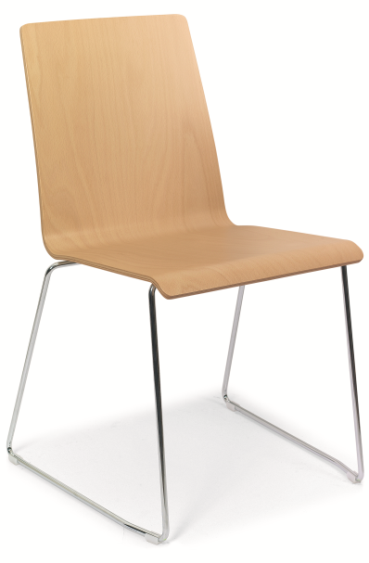
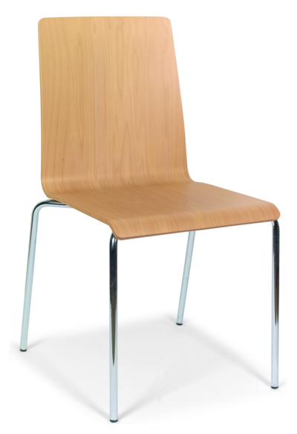
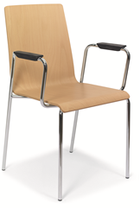
MOON (Wood) – Conference Chairs
SXA120
SXA100
SXA104
Conference Chairs’ Characteristics:
Available backrest and seat options: natural beech or oak veneer, black stained beech veneer or white laminate
Chrome-plated legs
Stackable (max 5)
Right – hand folding table (available only on chairs with armrests - SXA104)
Gliders which allow linkage of chairs to lines (only for models - SXA100, SXA104)

Slide 5
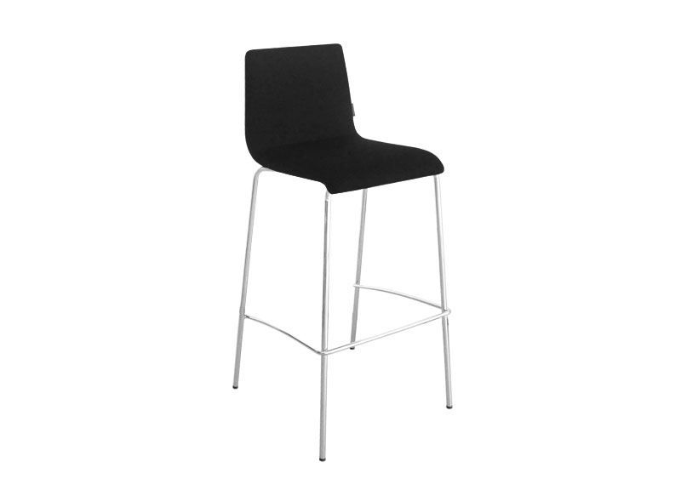
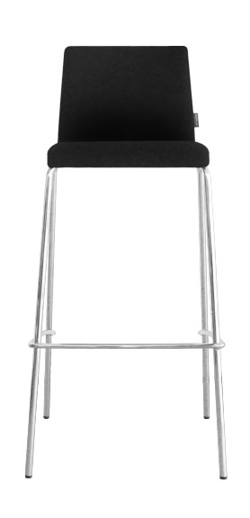
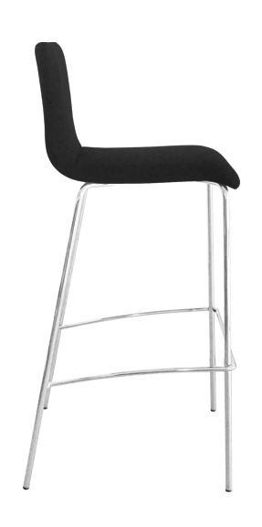
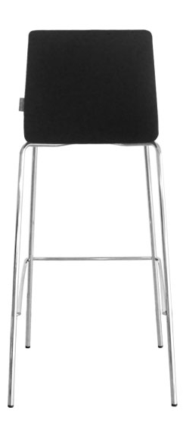
MOON – high chair
High chair features:
Chairs’ backrest and seat are upholstered with fabric, leather look or genuine leather;
Chair seat and backrest are made from a single piece of pressed plywood;
Chrome-plated legs (16mm diameter);
Stackable (max 5).

Slide 6
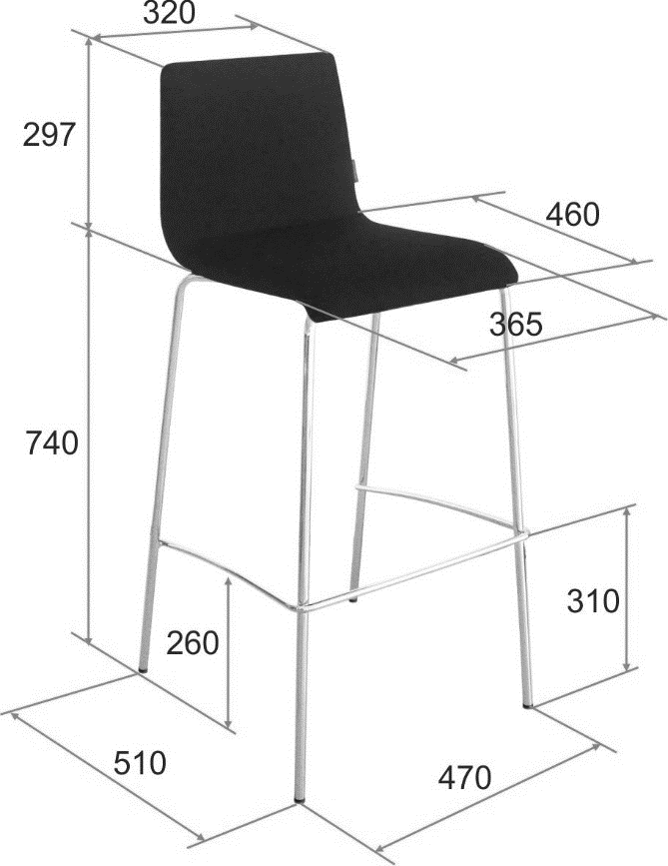
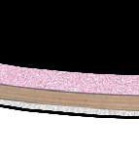
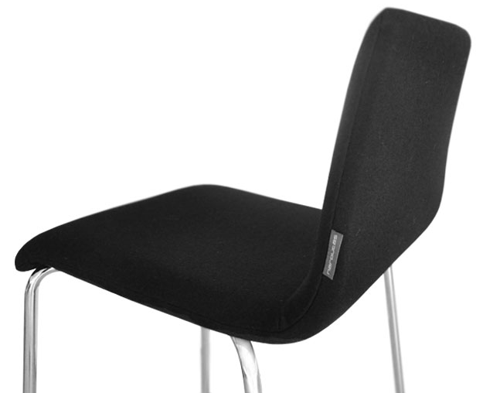
Technical information
Cut
Fabric
Foam (20mm, 50kg/m³)
Pressed plywood (10mm)
Foam (5mm, 50kg/m³)
Fabric

Slide 7
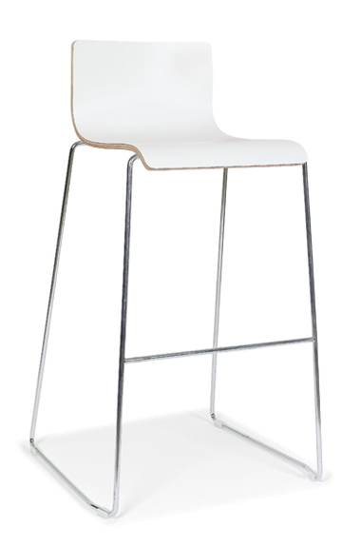
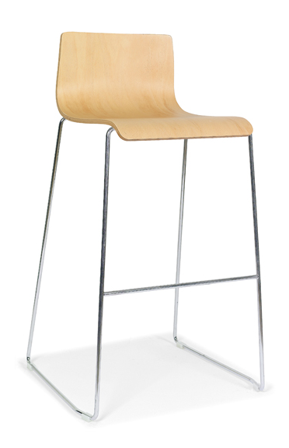
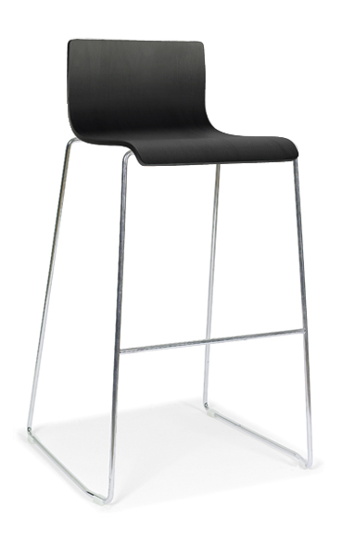
MOON – high chair (wood)
High chair features:
Chairs’ shell - backrest and seat - made of veneer: Beech / Oak / White matt birch laminated / Beech stained black;
Chrome-plated steel legs and frame;
SXA500
W=525, D=420, H=940, SH=730

Slide 8
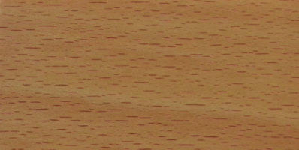
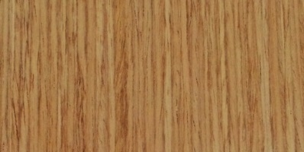

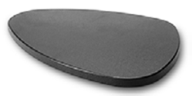
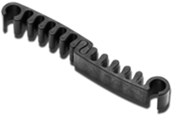

MOON textures and supplements
Veneer:
Supplements :
Z1- beech
Z2 - oak
Z4 – black stained beech
ZUZ002
Laminate:
Z3 – white laminate
ZXZ002
Fabric: Twist, Bondai, Xtreme Plus, Velito
Natūral leather: DNN
Leather look: RNN

