Slide 1
EVA.II
CHAIR SYSTEM

Slide 2
Chair system
EVA.II
Elegance and practicality
Design – Marc Ayache
This slashing and elegant design chair perfectly integrates into modern office environment.
EVA.II system includes executive and operative chairs:

Slide 3
Operative chair
EVA.II
Seat upholstered with leather or fabric. The back is made of mesh;
Adjustable lumbar support (optional);
The chair available with fixed, height adjustable armrests or without them;
2 types of synchro mechanisms;
Plastic or aluminum base;
65 mm castors (plastic or covered with rubber).

Slide 4
Executive chair
EVA.II
Headrest covered with a soft polyurethane;
Seat upholstered with leather or fabric. The back is made of mesh;
Adjustable lumbar support (optional);
The chair available with fixed, height adjustable armrests or without them;
2 types of synchro mechanisms;
Plastic or aluminum base;
65 mm castors (plastic or covered with rubber).

Slide 5
Executive chair spectrum
EVA.II
SID030
SID230
SID130
SID530
SID330
SID430
SID630
SID730

Slide 6
Operative chair spectrum (black frame)
EVA.II
SIC220
SIC430
SIC520
SIC730
SIC530
SIC630
SIC830
SIC930

Slide 7
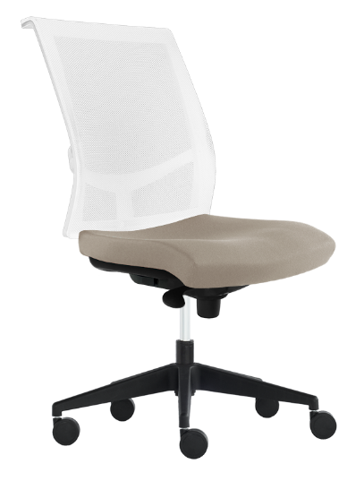
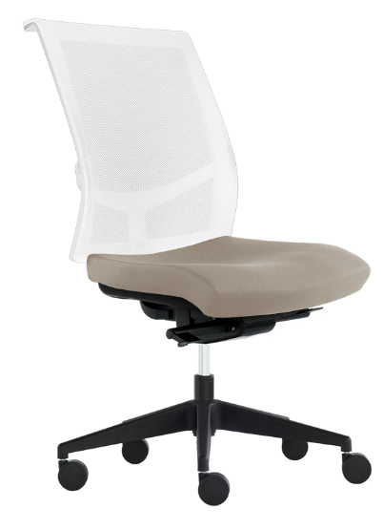
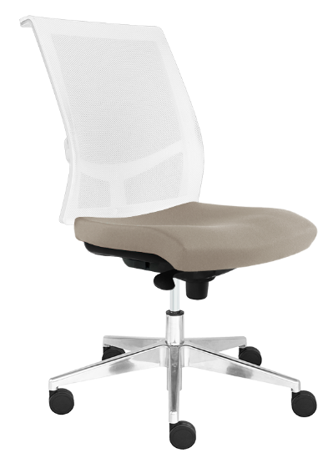
Operative chair spectrum (white frame)
EVA.II
SIC620
SIC720
SIC030
SIC130
SIC820
SIC920
SIC230
SIC330

Slide 8
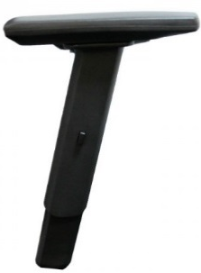
Options
EVA.II
Choose from 6 types of armrests:
2D (two directions) armrests are adjustable in height, the upper part coated with a PU (polyurethane) pad, soft touch. The top of armrests moving forward or backward. The lower part is made of polished aluminium.
Height adjustable armrests, top part is covered with soft polyurethane. The top of armrests moving forward or backward.
Fixed
plastic
armrests.
SZZ103-A
SZZ101-A
SZZ000-A
Height adjustable armrests.
Height adjustable armrests.
SZZ100-A
SZZ100-E

Slide 9
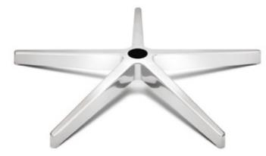
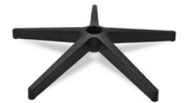
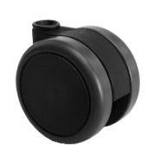
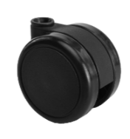
Options
EVA.II
2 types of bases:
Polished aluminum base ø 680 mm.
Plastic base with fiberglass ø 680 mm.
Choose from 2 types of castors:
Castors covered with rubber for hard floors, ø65mm.
Plastic castors for soft floors, ø65 mm.

Slide 10
Mechanisms and their control
EVA.II
Epron Plus Synchro mechanism (tension adjustment with a side lever)
Epron Synchro mechanism

