Slide 1


COSY
RECEPTION FURNITURE

Slide 2

A first impression is a lasting impression.
Clean, modern look with no sharp corners on the front side to make your office look welcoming, friendly and cosy for visitors.

Slide 3
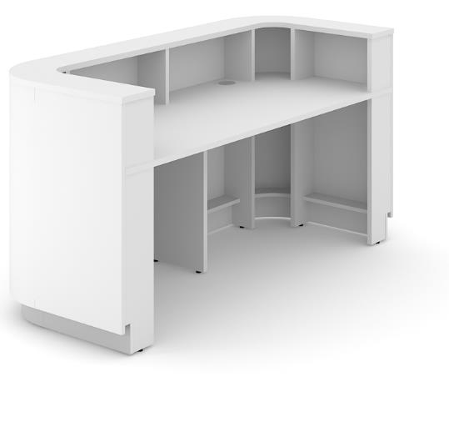
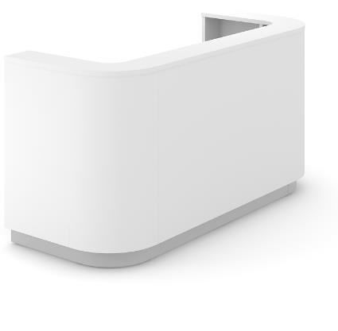
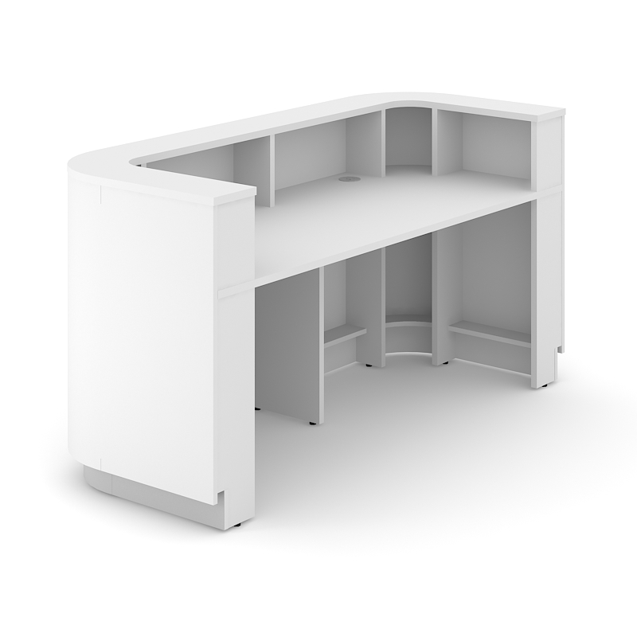
High modesty panel – CPL;
Supports and desktops – white melamine (M1);
Plinth – polished aluminium color HPL.
Texture:
CPL / Melamine M1

Slide 4


