Slide 1
ARCIPELAGO Wood
LOUNGE SEATING

Slide 2
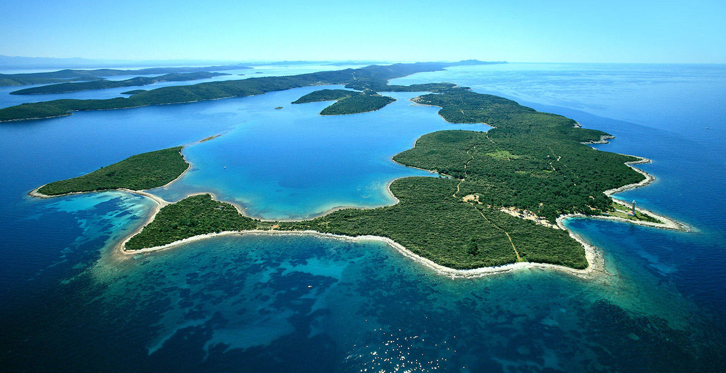
„One of the distinguishing features of an island is the natural protection. An island is a fortress, a castle in the middle of the sea.”
Adriano Baldanzi

Slide 3
„Here it is, our fortress in the ARCIPELAGO Wood. A space where you can rediscover a calm, reserved place where you can find concentration and privacy, a workplace protected from the surrounding space.”
Baldanzi & Novelli Designers

Slide 4
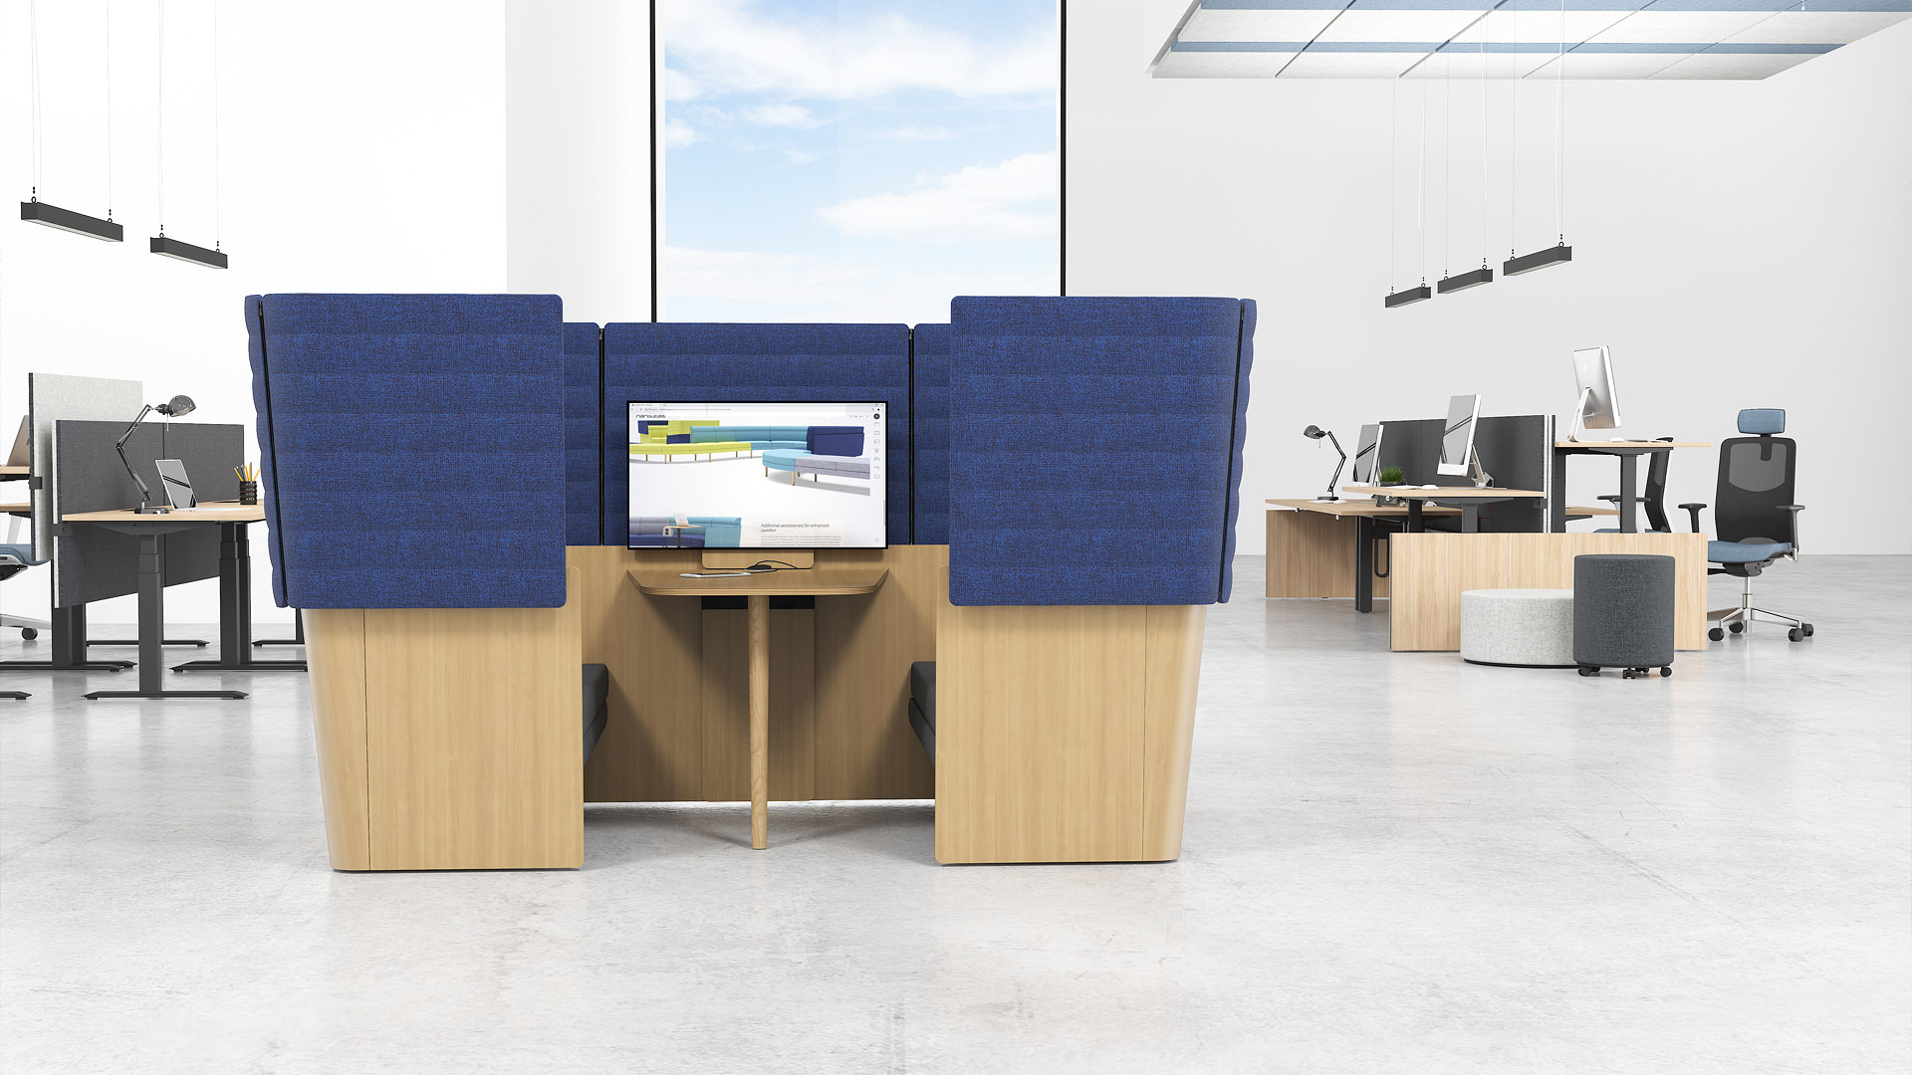

Slide 5
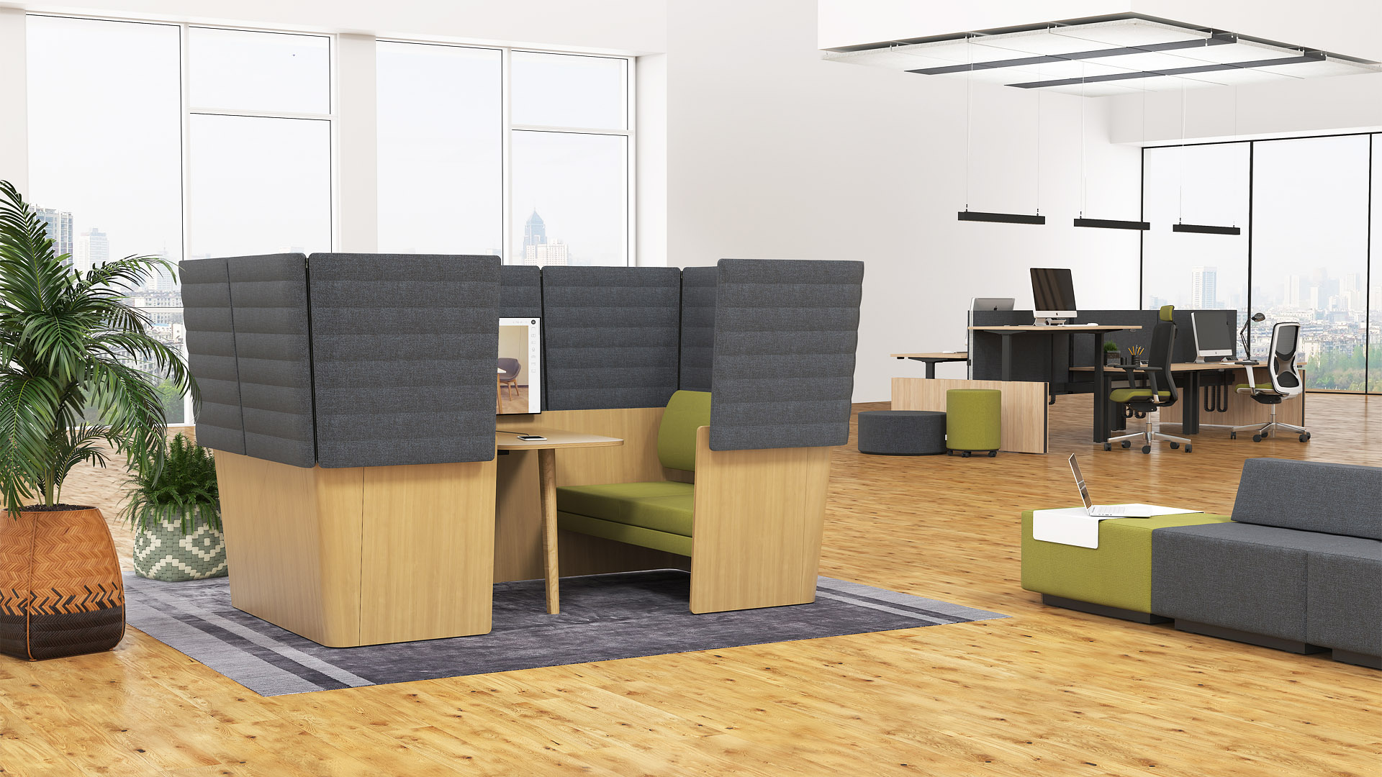

Slide 6
ARCIPELAGO Wood
This office lounge seating will allows you to create “a room within a room” in open-plan offices. It will act as a shield from a surrounding noisy environment.

Slide 7
Design Adaptability Comfort Functionality Variety of combinations

Slide 8
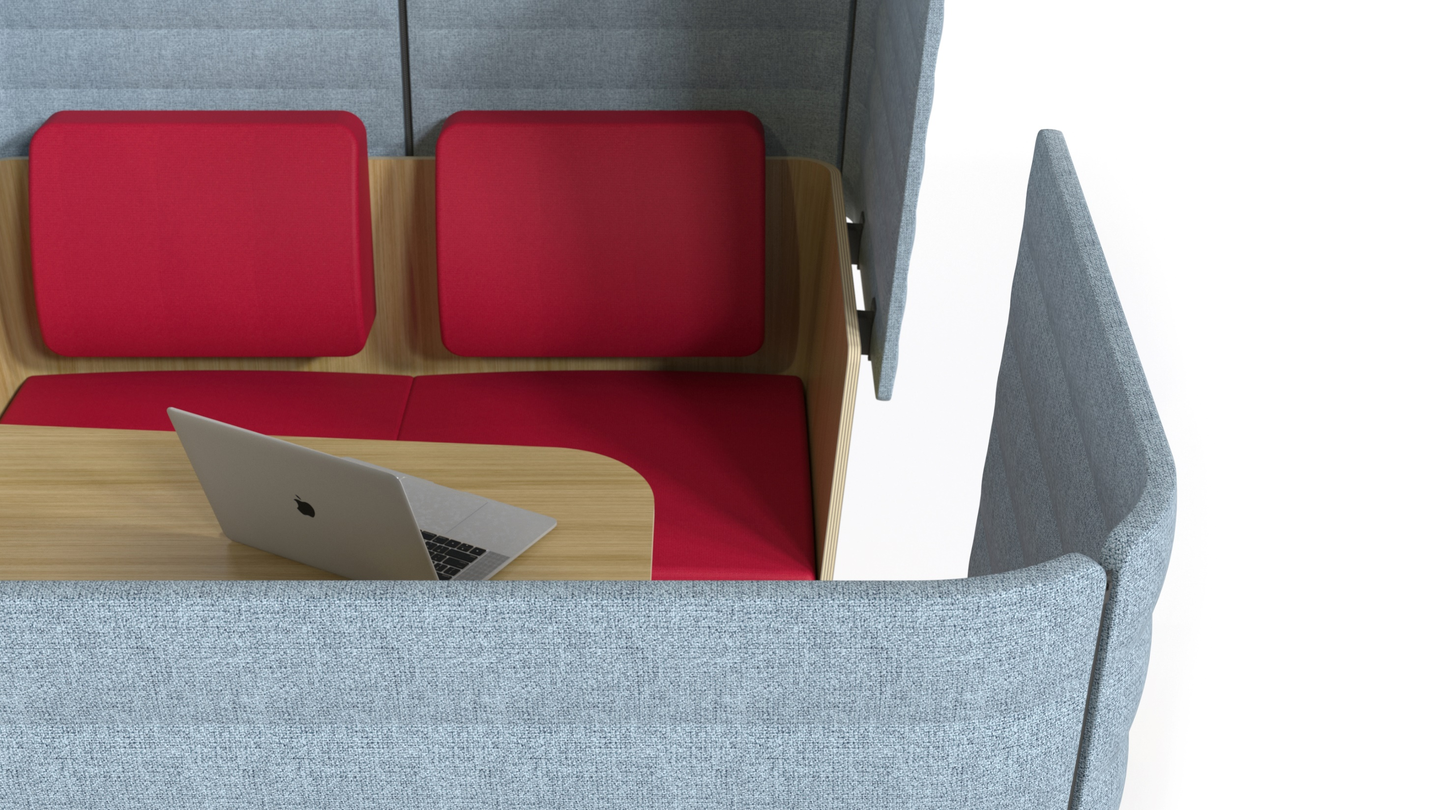
Aesthetic design, smooth shapes and natural elements bring a sense of warmth to the office.

Slide 9
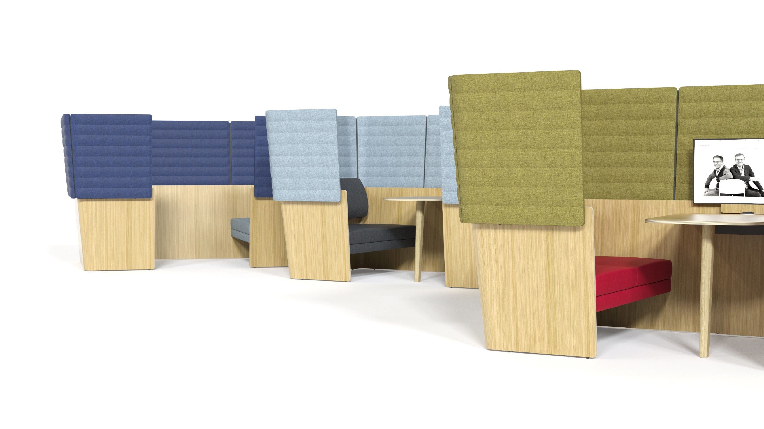
Adaptability
This lounge seating is ideal for multiple uses: brief tasks or longer work sessions, meetings, teamwork or relaxation.

Slide 10
Comfort
High panels serve as barriers shielding employees from background noise while comfortable seating creates a laid-back and private environment.

Slide 11
Functionality
The seating unit can accommodate a monitor screen for convenient presentation of information during business meetings. The table is equipped with a power socket with integrated USB type A and C connectors for any work devices to make sure you never run out of energy.

Slide 12
Variety of combinations
The use of natural elements and specific colours has a positive effect on productivity and mood of employees.
ARCIPELAGO Wood is a harmonious combination of oak veneered plywood and upholstered elements. Our wide colour palette allows you to choose colours that best fit your office style.

Slide 13
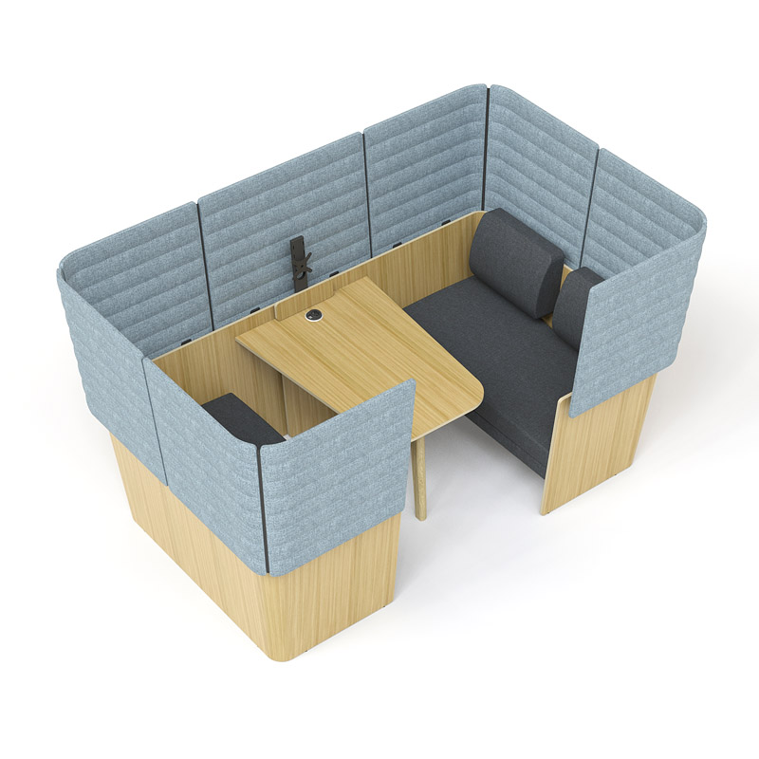
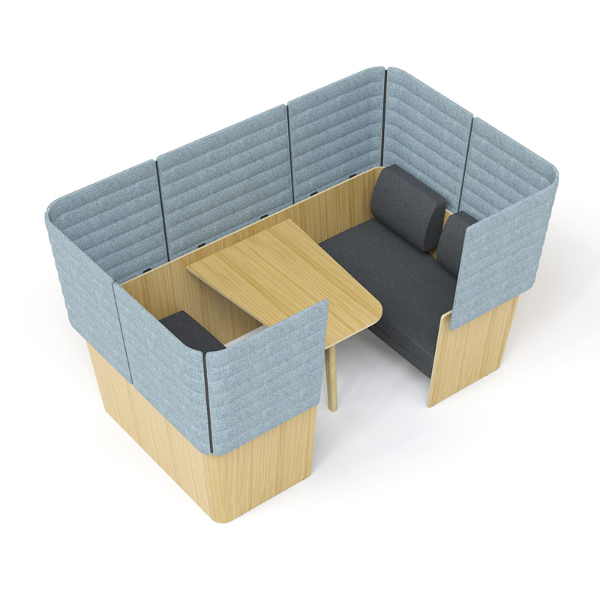
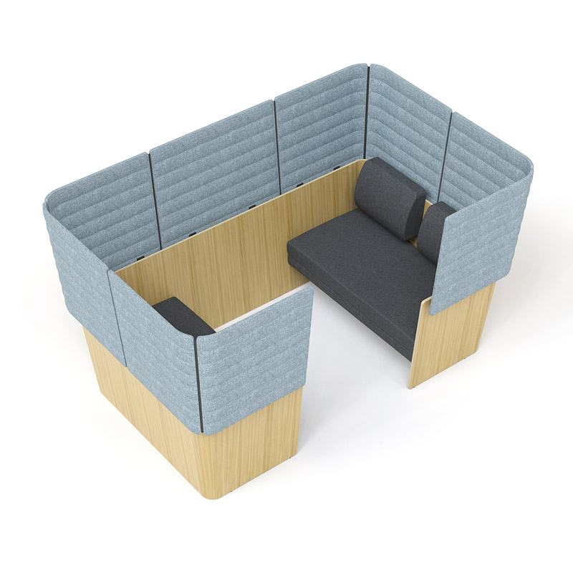
RANGE
4-seat lounge seating with a table, a power socket cut-out and a monitor holder
4-seat lounge seating with a table
4-seat lounge seating without a table
Note. A power socket must be ordered separately.

Slide 14
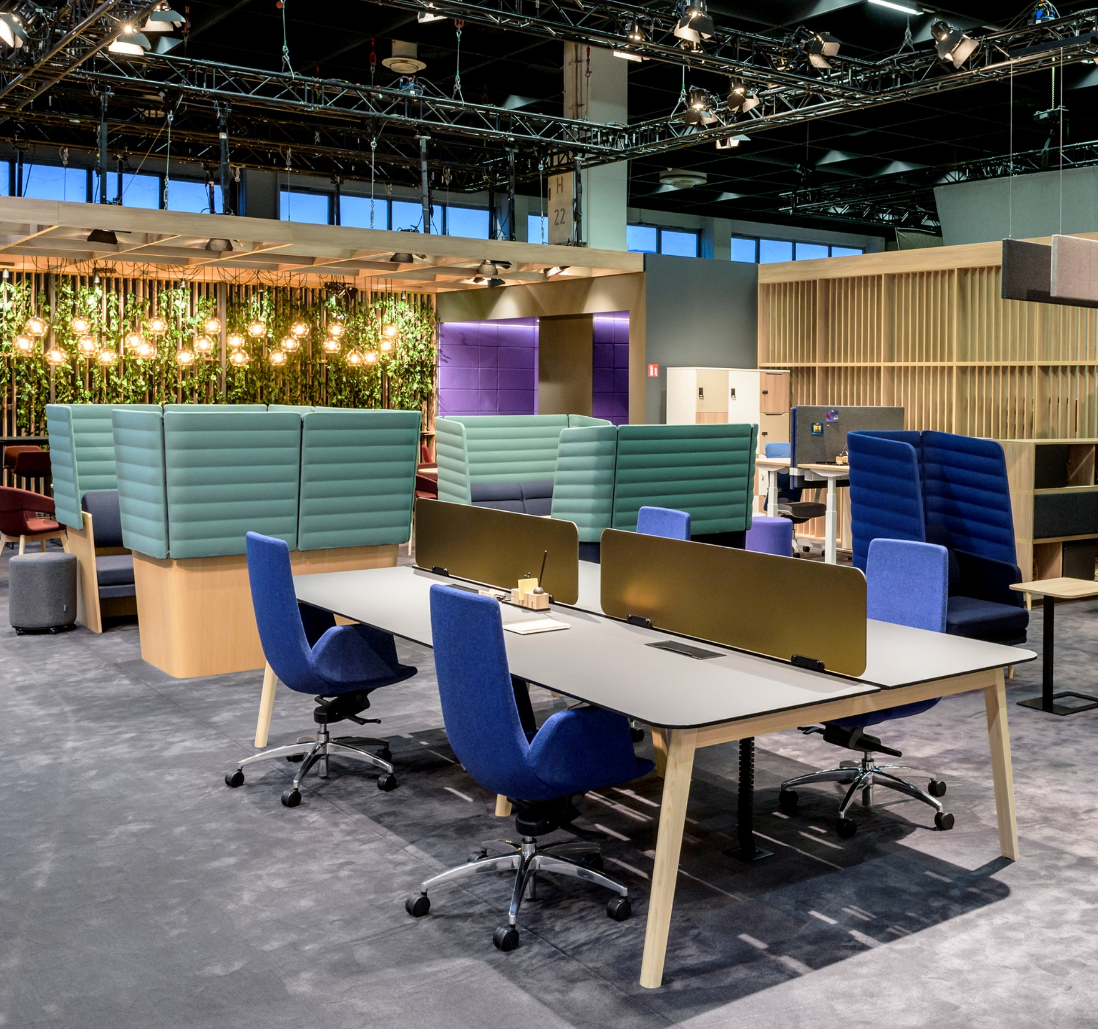
Successful debut at ORGATEC 2018!

